Slide 1
Continuous Flow CO₂ Cleaning is Now a Proven Technology That Can Economically Replace Energy Inefficient Aqueous Cleaning

Slide 2

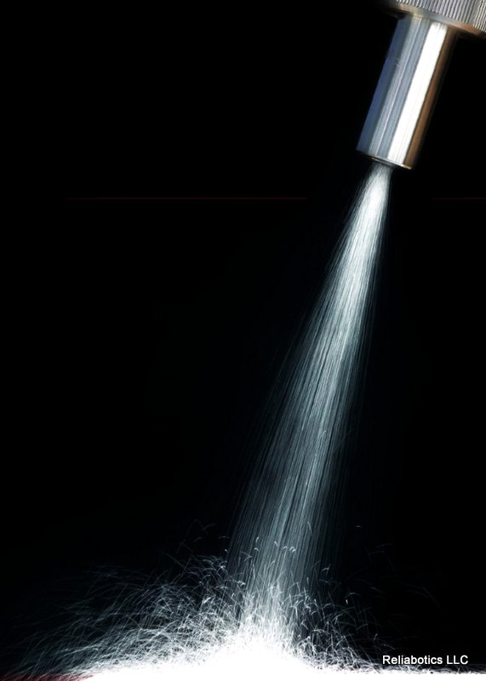
OVERVIEW
Continuous flow CO₂ cleaning is an economical an environmentally friendly alternative to aqueous cleaning.
CO₂ cleaning technology is an excellent tool to prepare surfaces for high reliability bonding processes

Slide 3
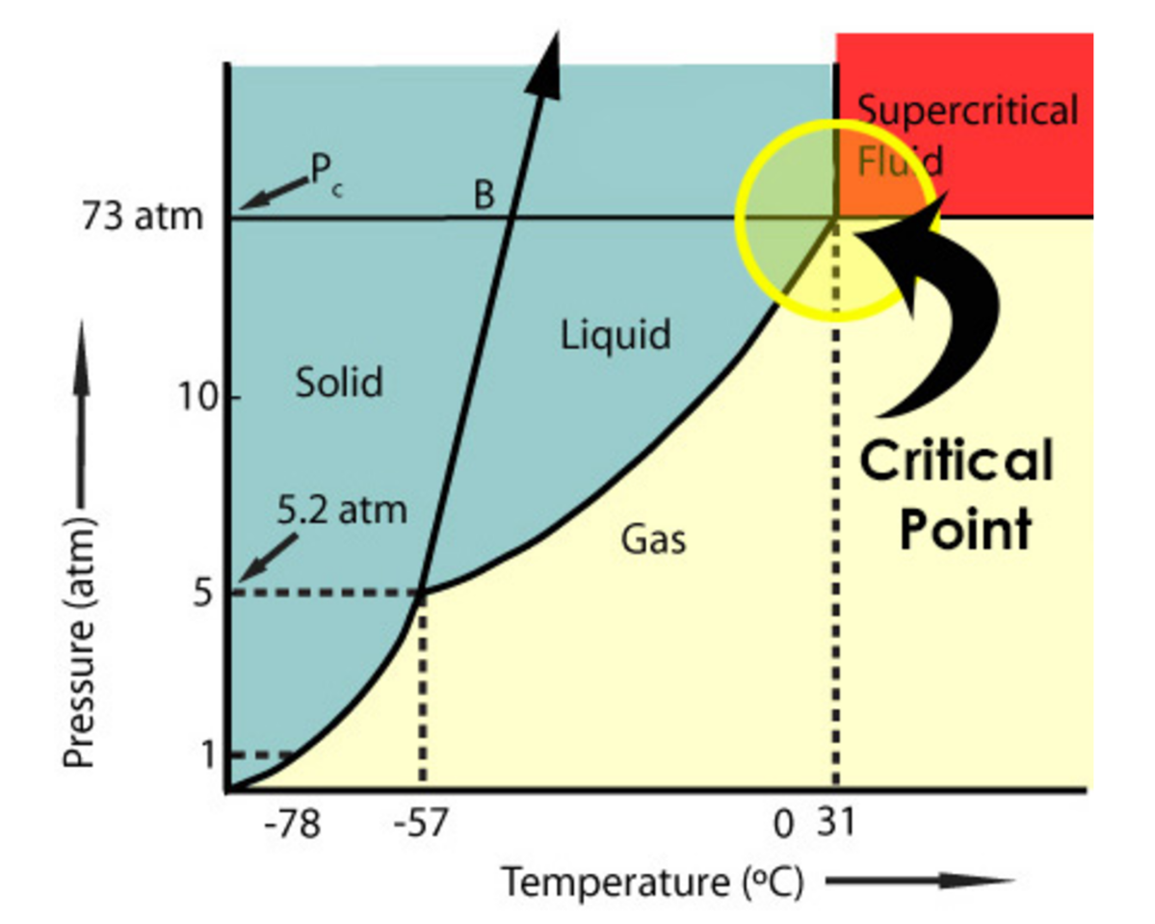
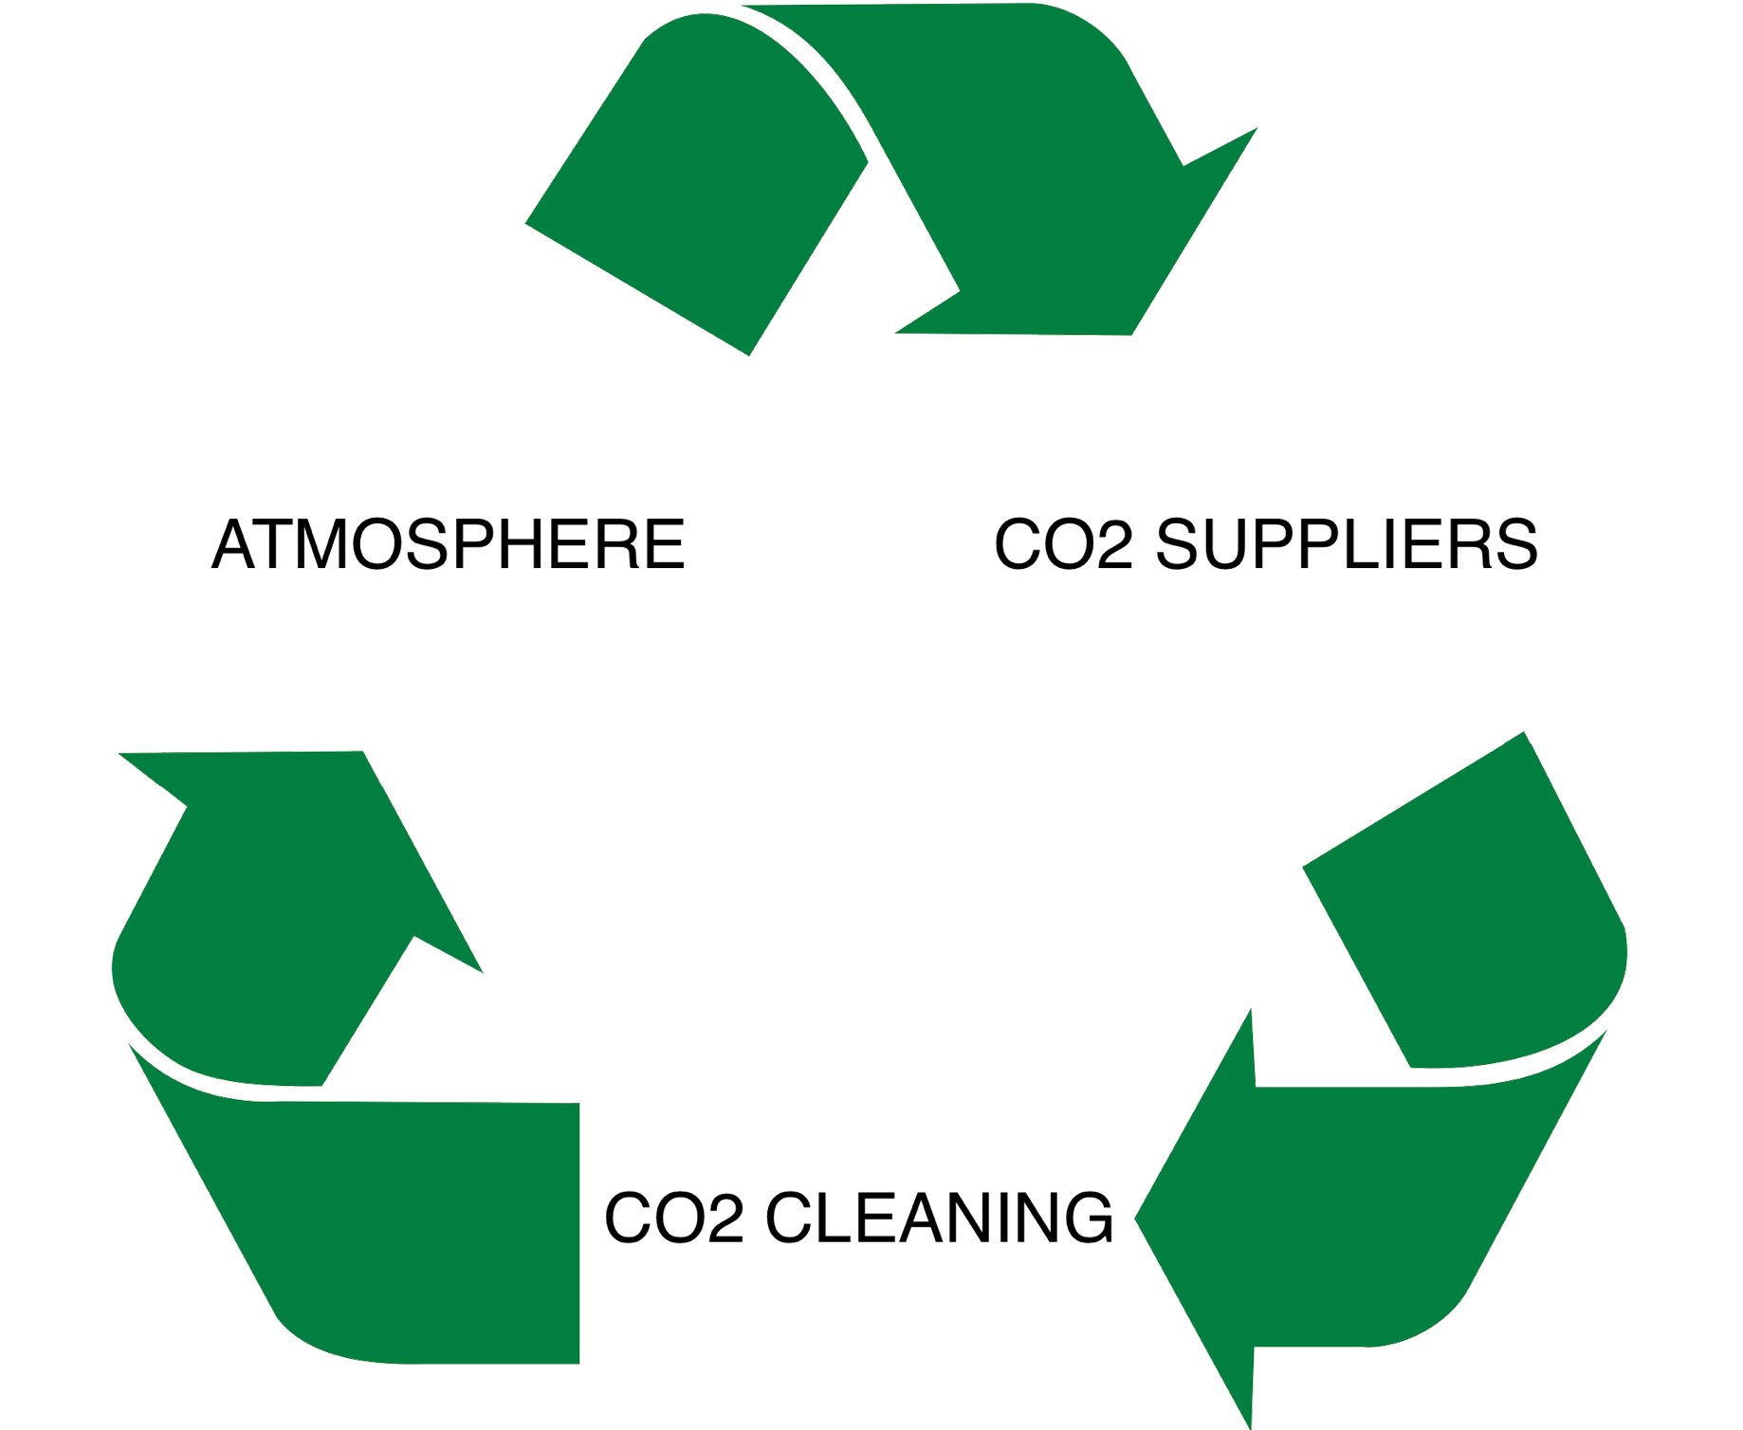

WHY CO2?
Relatively inexpensive and readily available
Well established Global distribution networks
Used in numerous industries such as Food and Beverage, Fire Extinguishing, and Welding
Its supercritical temperature is near Room Temperature
In a supercritical state, CO2 has extremely low viscosity and high solvency
In a solid frozen state, its solid particles can overcome adhesion forces to remove tough contaminants
CO₂

Slide 4
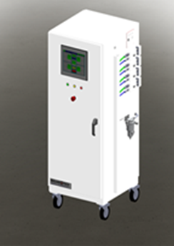
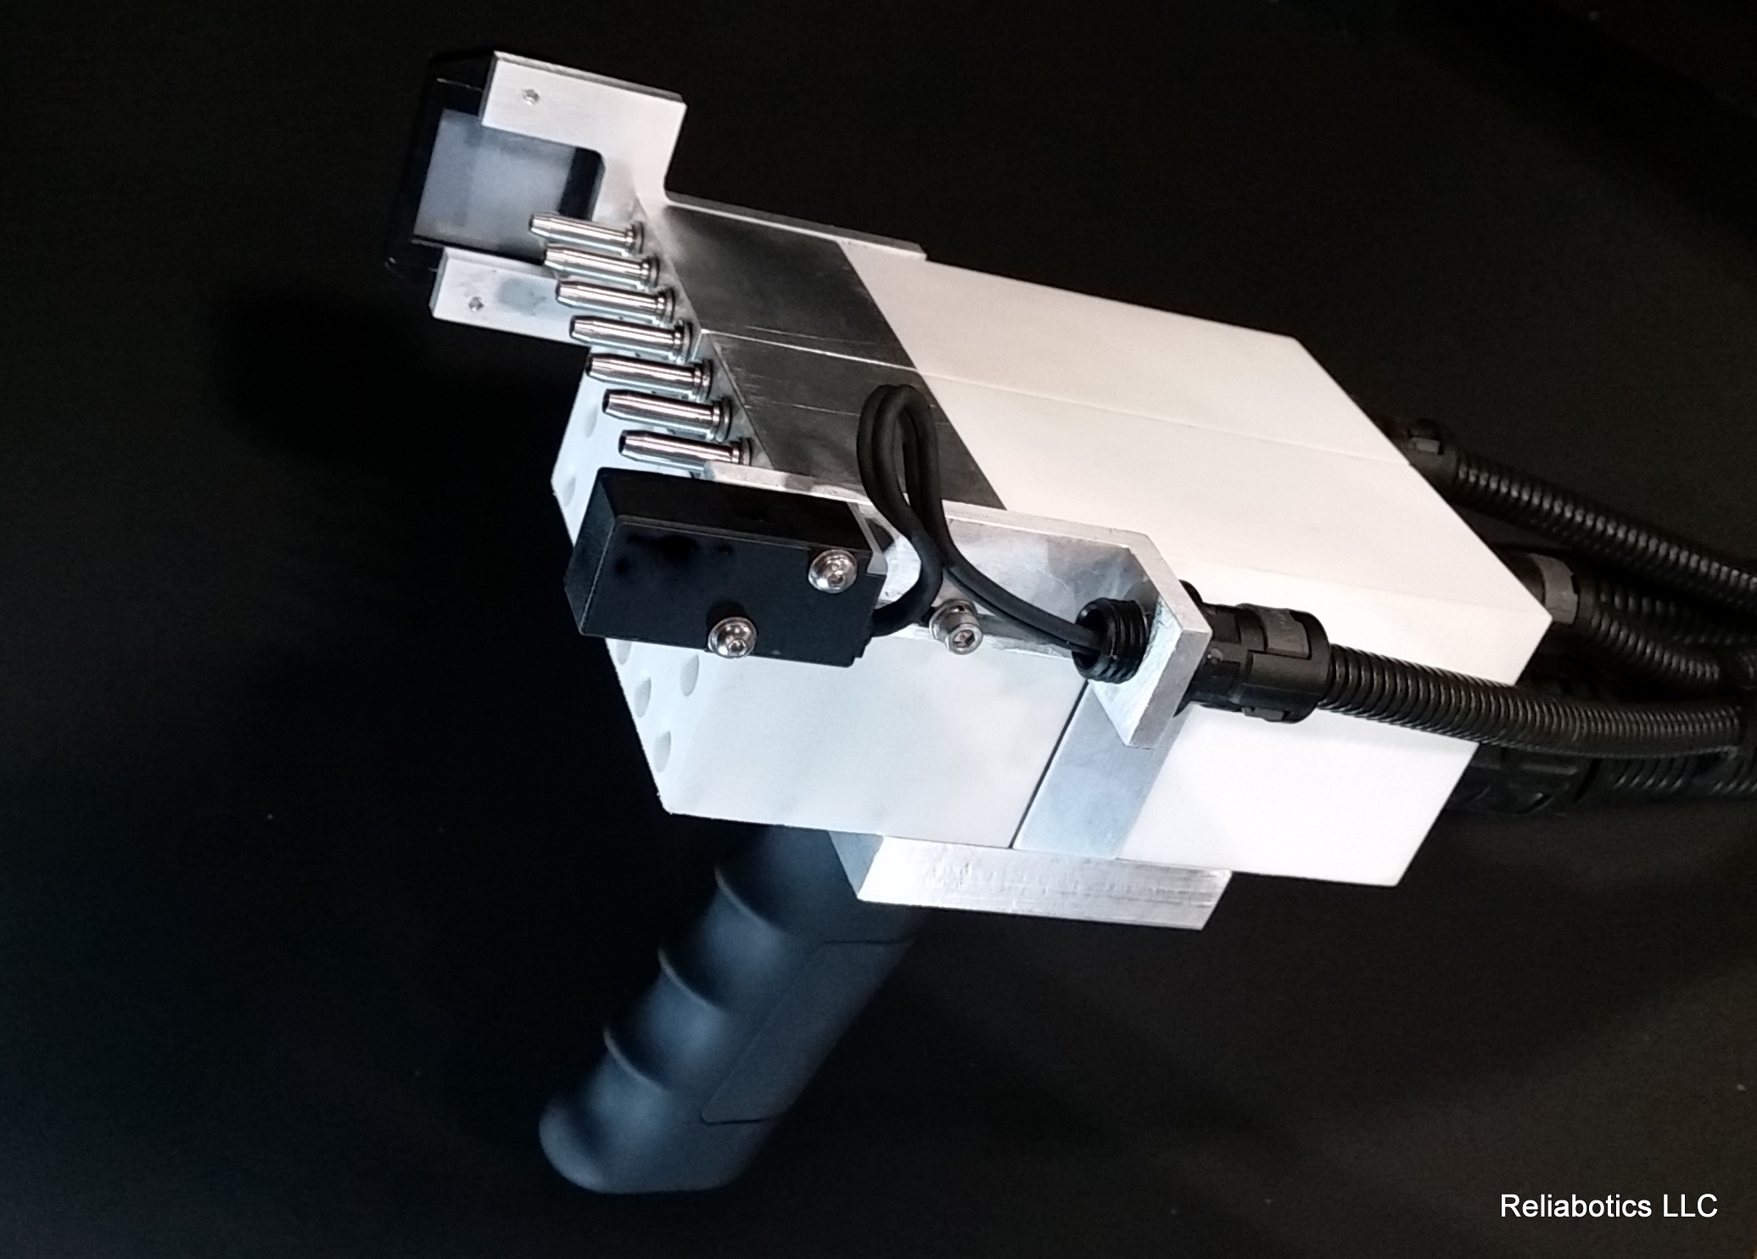
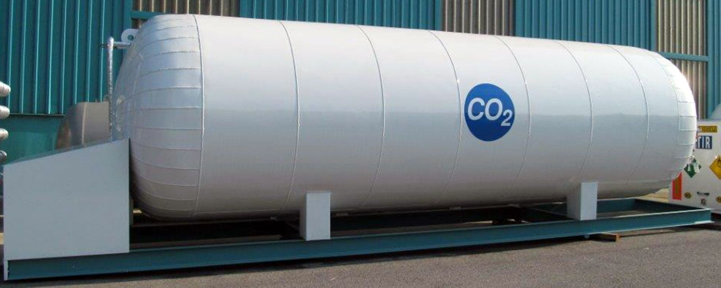
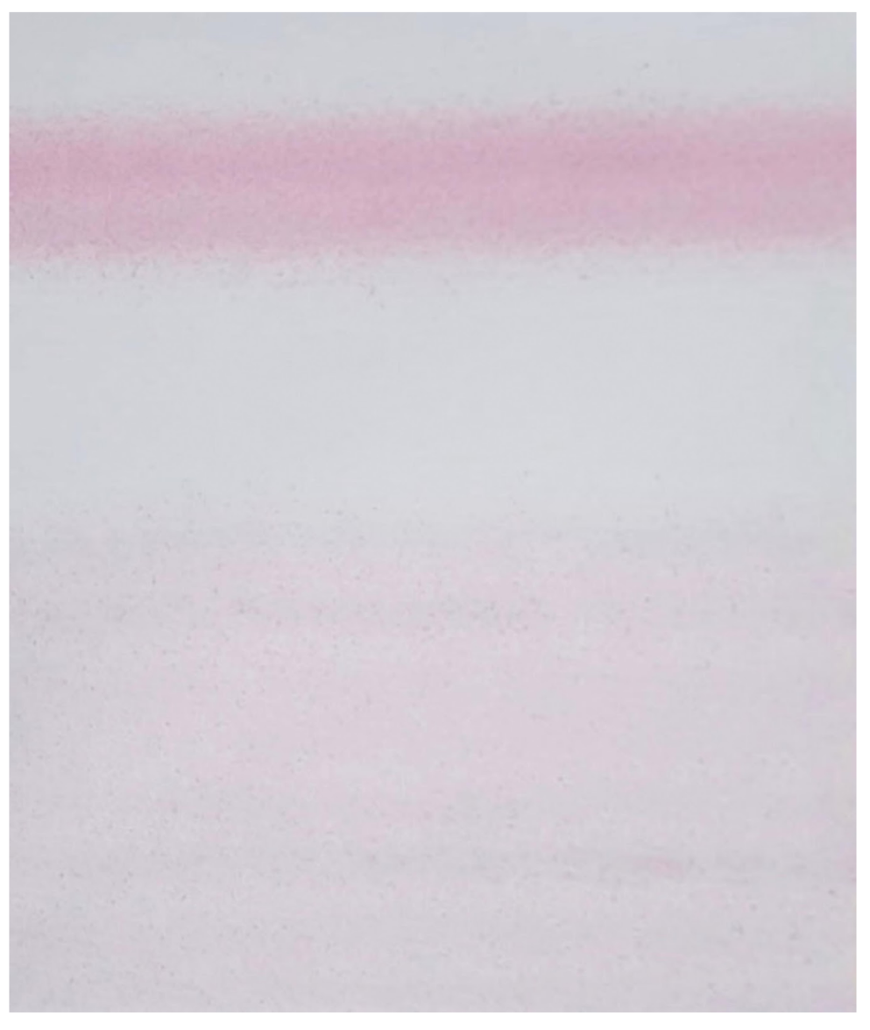
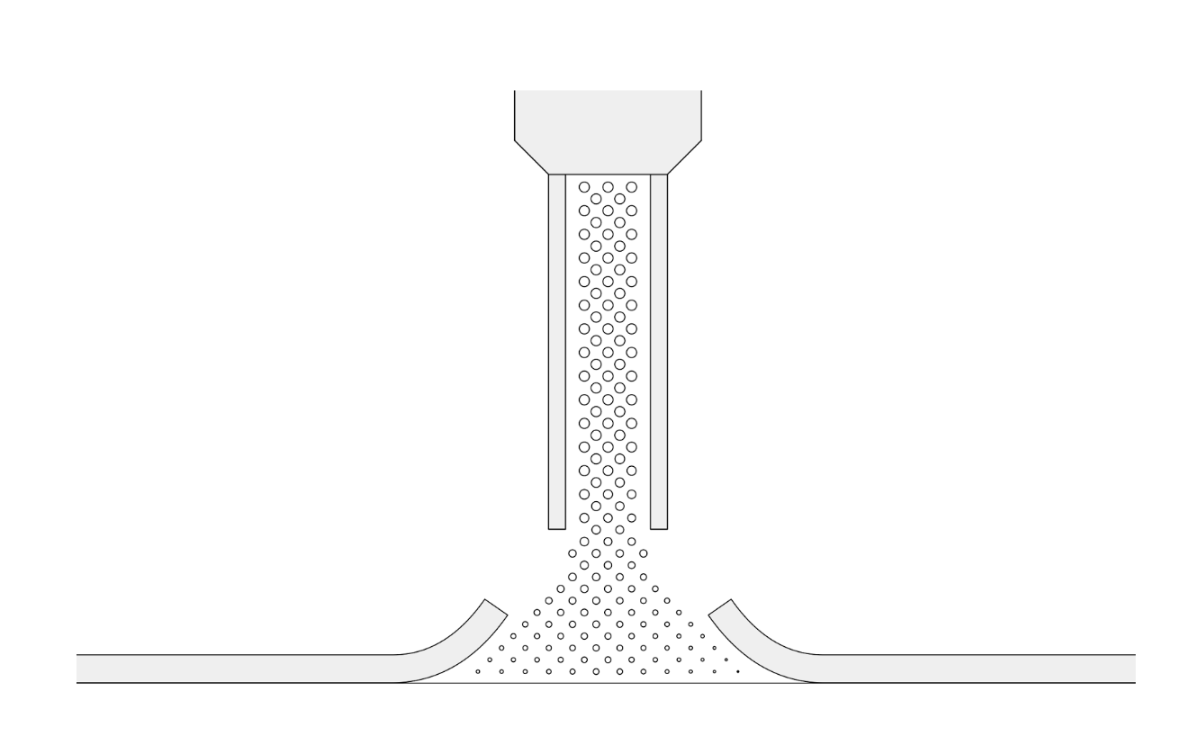
CO2 TECHNOLOGY PRINCIPLES
CO₂ Processing
Module
CO₂ Nozzle
Liquid CO₂ Storage Tank
High Pressure Configuration
CO₂ Exerted Pressure on Cleaning Surface
CO₂ Bullet Particle Profile
Low Pressure Configuration
Pressure Measurement Film

Slide 5
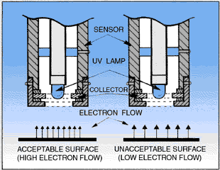
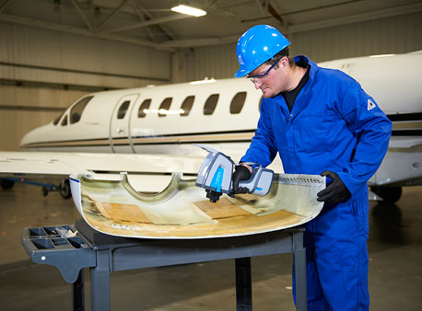
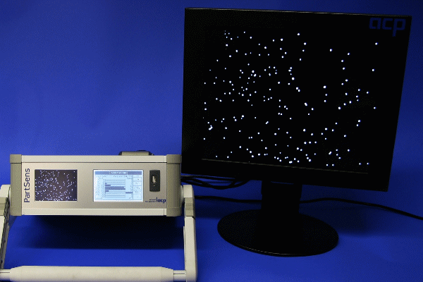
IN-LINE VALIDATION TOOLS
OSEE – Optically Stimulated Electron Emission
FTIR – Fourier Transform Infrared Spectroscopy
PartSens – Particle Counter

Slide 6
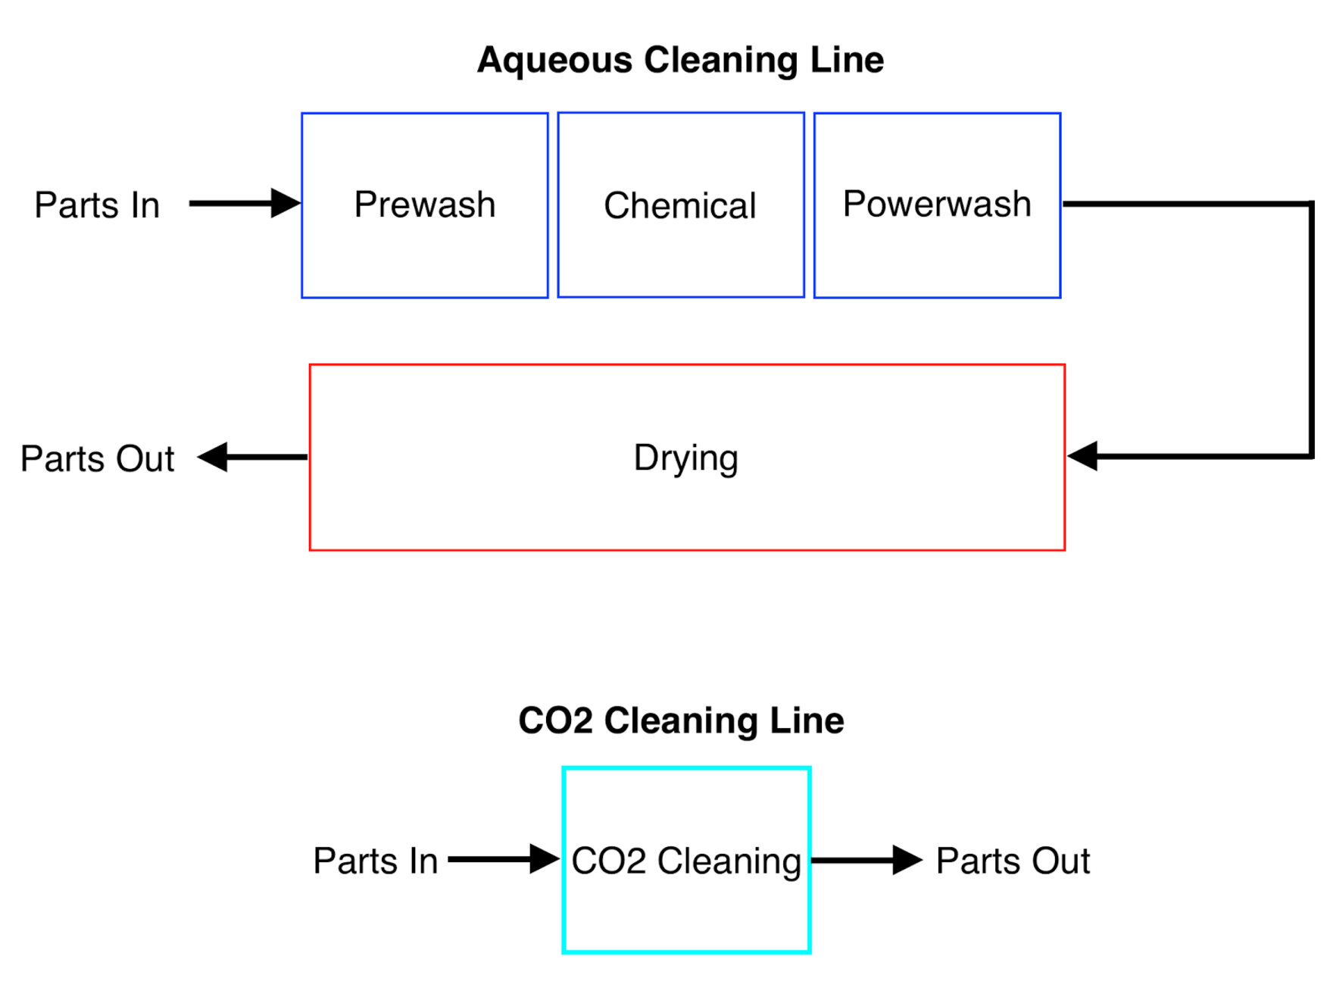
SAMPLE APPLICATION
Replacement of aqueous cleaning power wash line with a CO2 cleaning robotic booth prior to painting
Equipment foot print reduced from 2,500 sq.ft. to 400 sq.ft.
Eliminated 1% yield loss caused by aqueous water spotting on parts
Reduced upfront capital investment costs as well as operating and maintenance costs.
 | AQUEOUS | CO₂ | REDUCTION
Capital Investment | $900K | $500K | 45%
Annual Operating Costs | $186K | $46K | 75%
Annual Maintenance Costs | $70K | $8K | 89%

Slide 7
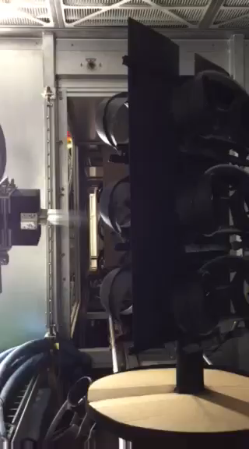
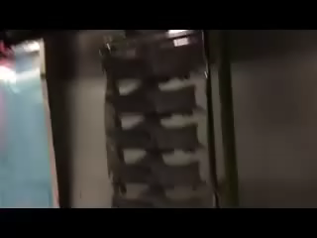
SAMPLE APPLICATION
Surface Area Cleaning prior to Painting Application

